Slide 1
DIGITAl media MARKETING using Neural Network system
Presented by
D.BHUVANESHWAR and B.PAVITHRA BSC CS
Under the guidance of
Mrs Shunmugapriya K
Assistant Professor
Department of Computer Science and Applications
Jeppiaar College of Arts and Science,Padur.

Slide 2
AGENDA
ABSTRACT
INTRODUCTION
EXISTING SYSTEM
PROPOSED SYSTEM
CONCLUSION
FUTURE ENHANCEMENT
REFERENCE

Slide 3
ABSTRACT
For the past few years, E-Commerce is the most popular platform that we using in our day-to-day life. The definition of e-commerce business can also include tactics like affiliate marketing. Advertising the products is the major challenge in E-Commerce.
In E-Commerce, also called online marketing, is the promotion of brands with potential customers using the internet and other forms of digital communications. Basically, Advertising the products in this Digital media marketing platform is the most challenging task.
Every people have their own need depends on their requirements. In this project, Using “Market Basket Algorithm” in a particular area by Neural network system using regression, we can handle and advertise the products to the preferred specific people through online platforms like Facebook, Instagram etc…
Neural networks are designed to work just like the human brain does, And market basket algorithm is used to increase sales by better understanding customer purchase patterns.

Slide 4
INTRODUCTION
Digital marketing is the use of digital technologies and platforms to promote products and services, as well as to connect with potential customers. Digital marketing utilizes multiple digital technologies to deliver promotional messages, such as mobile phones, computers, and other digital media and platforms.
It can be used for B2B (Business to Business) and B2C (Business to Consumer) marketing, depending on the goal and objectives of the campaign. Digital marketing offers unique advantages such as greater reach, improved targeting, personalized messaging, and better ROI (Return on Investment. With the right strategies and tactics, companies can leverage digital marketing to increase their visibility and reach a larger audience.
It has many advantages, but has some disadvantages too. Some disadvantages are security and privacy issues, trust and credibility, advertising, time consumption and accessibility etc. this paper mainly focus on the advertising part. because, various methods were undertaken to advertise the products like bit notice, wall paintings and so on. But it reaches on to a very few people.so we are going to advertise through social media.

Slide 5
EXISTING SYSTEM
Digital advertising is a process of migration and adaptation of companies to the movement that society as a whole has undergone. The 4 best digital advertising examples are Search engine marketing, display advertising, social media ads and email marketing.
In this work we consider social media ads as our existing system. Social media platforms allow users to spend time with more relevant content than traditional advertisements; social media marketing has a wide range of benefits for businesses, including improved brand recognition, targeted advertising, cost-effectiveness, and in-the-moment engagement.
Businesses must carefully balance the advantages and disadvantages before developing a social media marketing strategy that works for their unique objectives and target market. In the digital age, social media marketing can without a doubt be a game-changer for driving business growth and creating deep connections with customers. So in this work we are going to modify the social media advertising by adding our techniques.

Slide 6
PROPOSED SYSTEM
NEURAL NETWORKS
A Neural Network is a machine learning program, or model, that makes decisions in a manner similar to the human brain, by using processes that mimic the way biological neurons work together to identify phenomena, weigh options and arrive at conclusions
Think of each individual node as its own linear regression model, composed of input data, weights, a bias (or threshold), and an output. The formula would look something like this:
∑wixi + regr = w1x1 + w2x2 + w3x3 + regr
output = f(x) = 1 if ∑w1x1 + b>= 0; 0 if ∑w1x1 + b < 0
Once an input layer is determined, weights are assigned. These weights help determine the importance of any given variable, with larger ones contributing more significantly to the output compared to other inputs. All inputs are then multiplied by their respective weights and then summed

Slide 7
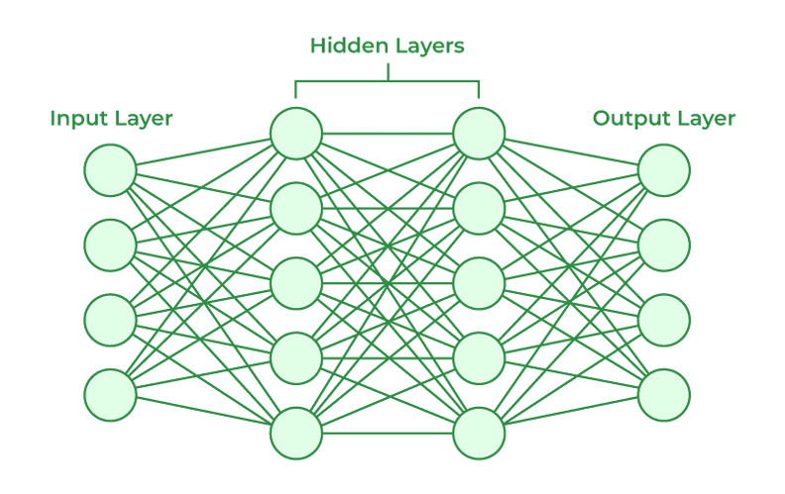
Afterward, the output is passed through an activation function, which determines the output. If that output exceeds a given threshold, it “fires” (or activates) the node, passing data to the next layer in the network.
This results in the output of one node becoming in the input of the next node. This process of passing data from one layer to the next layer defines this neural network as a feedforward network.
NEURAL NETWORK SYSTEM

Slide 8
CONCLUSION
The current state of E-Commerce in India is the topic of this research. Here we showed that we can advertise the products by combining those two fixtures very easily
Thus we concludes that ,In Neural networks we use regression method to take relevant data related to our preferred products and by using market basket analysis we can sell products which is related to their needs and will show relevant data related to them.
This paper helps to advertise the products to the targeted people very easily through Facebook, Instagram

Slide 9
FUTURE ENHANCEMENT
In future, we can add some more analysis and algorithms to get great results in real time world.
Thus, we concludes that in Digital Media Marketing using Neural Networks ,We can advertise the products very easily.

Slide 10
THANK YOU!
“In commerce, staying ahead of the competition is the constant challenge.”

